Slide 1

Virus demonstration
Ha Noi University of Science and Technology
Object-oriented and Programming Project
Group 7

Slide 2
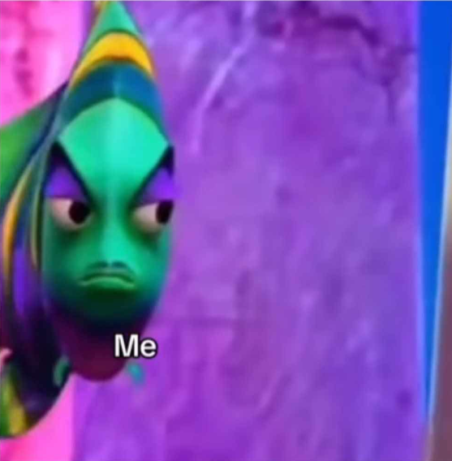



Member introduction
Nguyễn Lê Đăng Khoa
20226049
Nguyễn Trung Dũng
20226030
Nguyễn Phương Anh
20226011
Nguyễn Ngọc Hưng
20226044

Slide 3

Project outline
1
3
5
Problem
Object-oriented
Techniques
Demonstration
2
4
Diagrams
Graphic
result

Slide 4
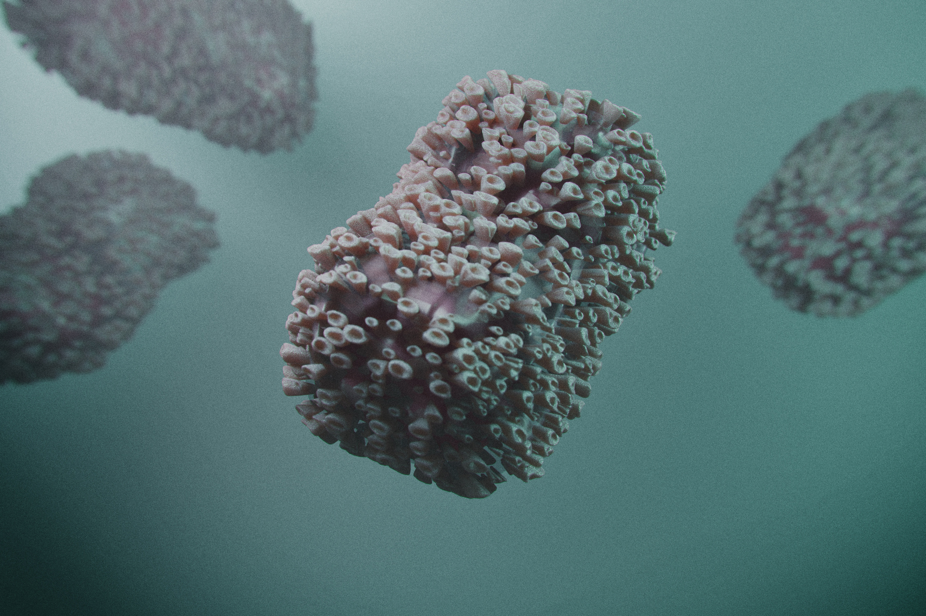
PART 1:
PROBLEM

Slide 5

Problem
Virus is a topic which is a large field in medicine → unfamiliar with SOICT students.
Some virus are common but not everyone understand about them exactly.
Aim:
Create a user-friendly app for everyone (we use JavaFX and basic Java properties for this app).
Provide useful knowledge about virus for people.
Provide basic knowledge about Java.

Slide 6

PART 2:
DIAGRAM

Slide 7
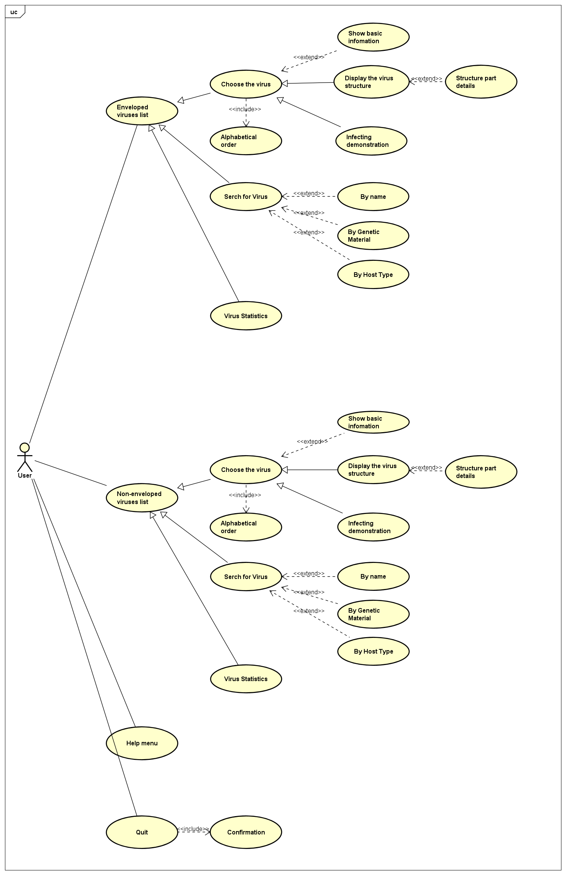
Usecase Diagram

Slide 8
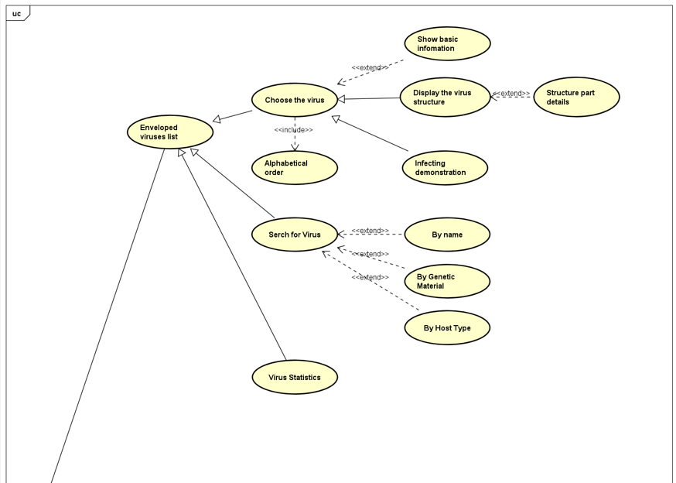
Usecase Diagram

Slide 9
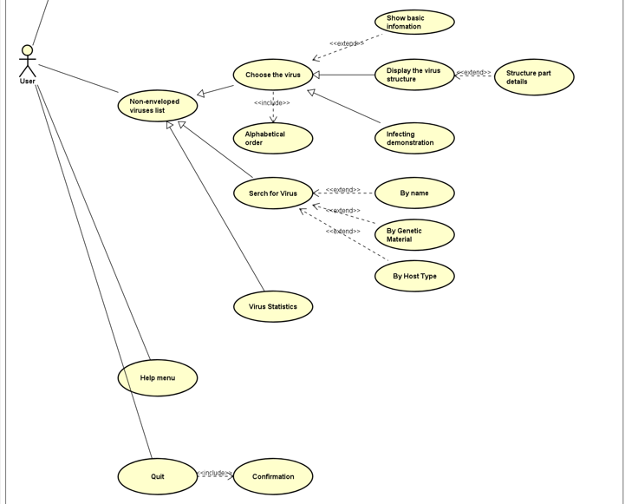
Usecase Diagram

Slide 10
Class Diagram

Slide 11
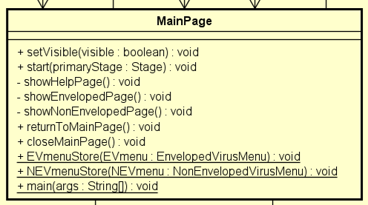
Class Diagram

Slide 12
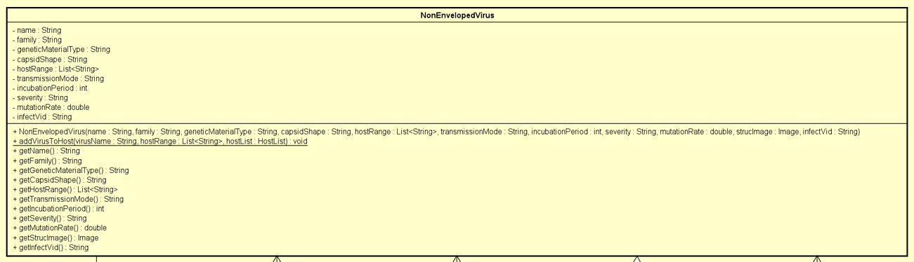
Class Diagram

Slide 13
Class Diagram

Slide 14
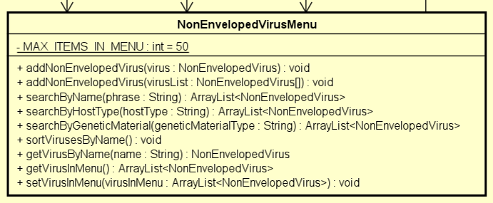
Class Diagram

Slide 15
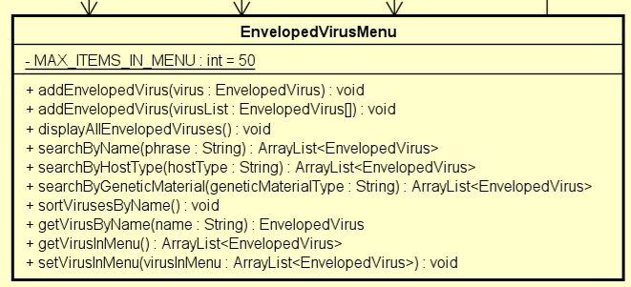
Class Diagram

Slide 16

PART 3:
OBJECT-ORRIENTED TECHNIQUES

Slide 17
OOP Techniques
Inheritance
Enveloped Virus inherits all the attributes from Non-enveloped Virus (add the envelope composition attribute).
Main page inherit from javafx.application.Application.
EnvelopedVirsPage or EnvelopedVirusMenu inherit from Stage in javafx.stage.Stage.
Encapsulation
Every attributes and method are logically implemented.
Ex: In the EnvelopedVirusMenu class, max items in menu can not be change and set as private, while objects in the menu is public as well as other functions like adding, searching and sort.

Slide 18
OOP Techniques
Polymorphism
Create different method like adding in Menu class with the same name and different methods.
Overiding: start method in the Main page.
Aggregation
The class Virus and VirusMenu has a relationship
If one is deleted the other still stays

Slide 19
OOP Techniques
Composition
The “Belong-To association
The MainPage have the EnvelopedVirusPage as well as the Non-EnvelopedVirusPage
Interface
JavaFX based project
Eventhandler for button or search querry

Slide 20
PART 4:
GRAPHIC RESULTS

Slide 21
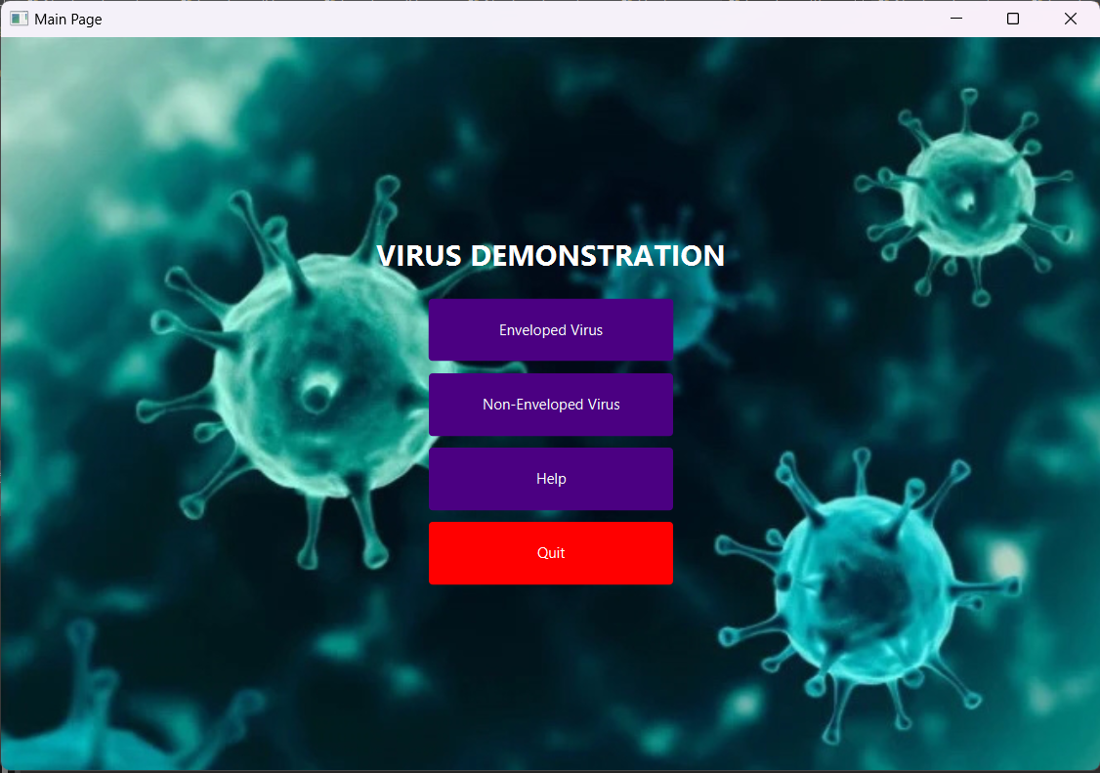
Graphic results
Main page

Slide 22
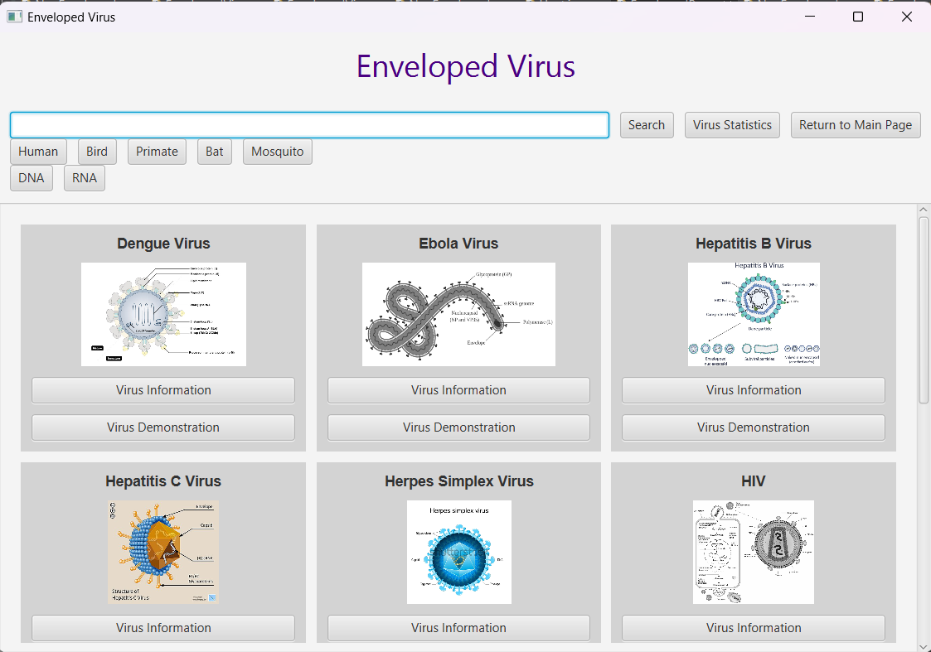
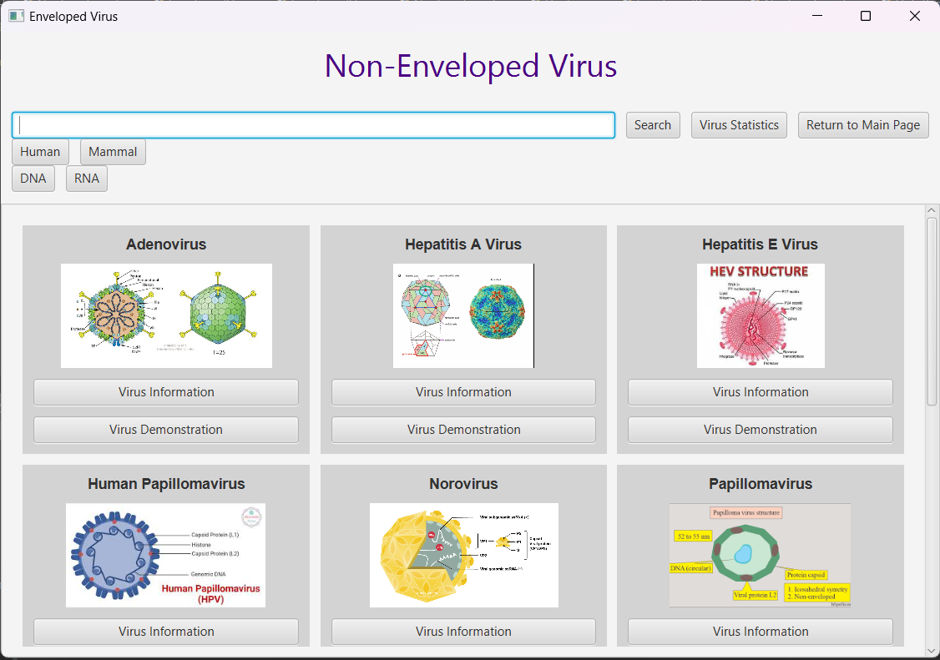
Graphic results
Menu page

Slide 23
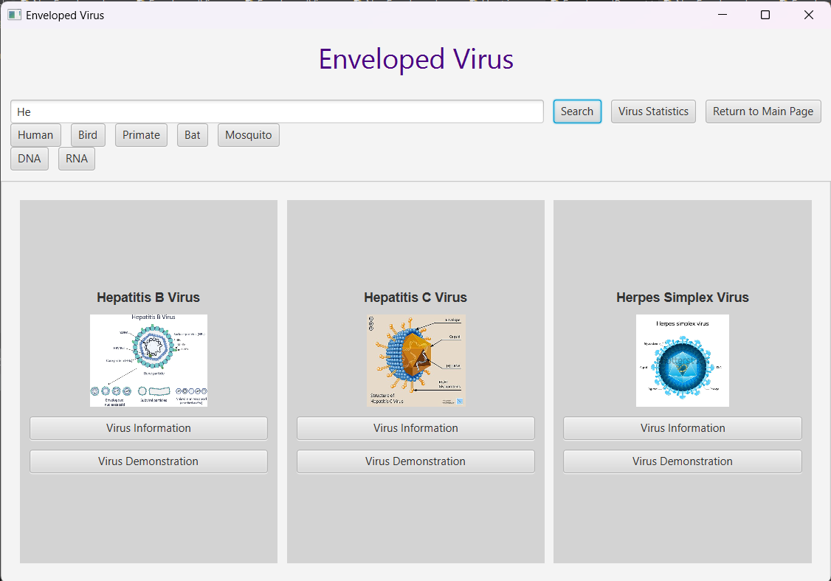
Graphic results
Menu page
We can also filter the virus by searching their properties

Slide 24
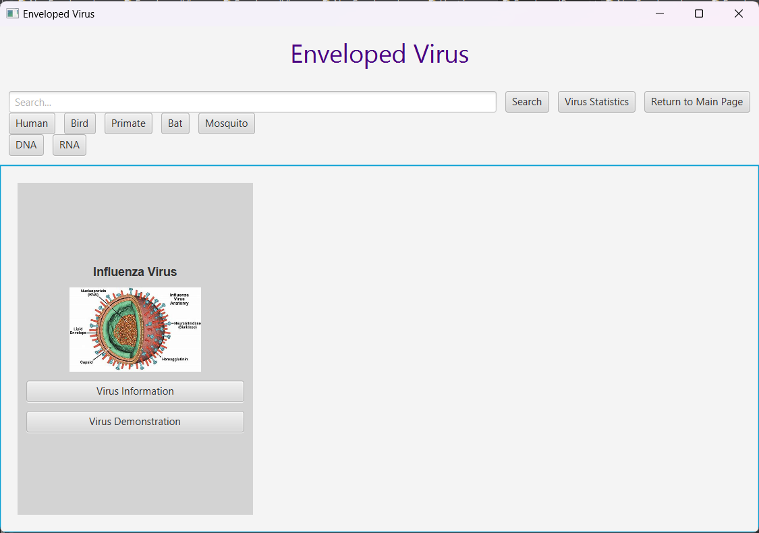
Graphic results
Menu page

Slide 25
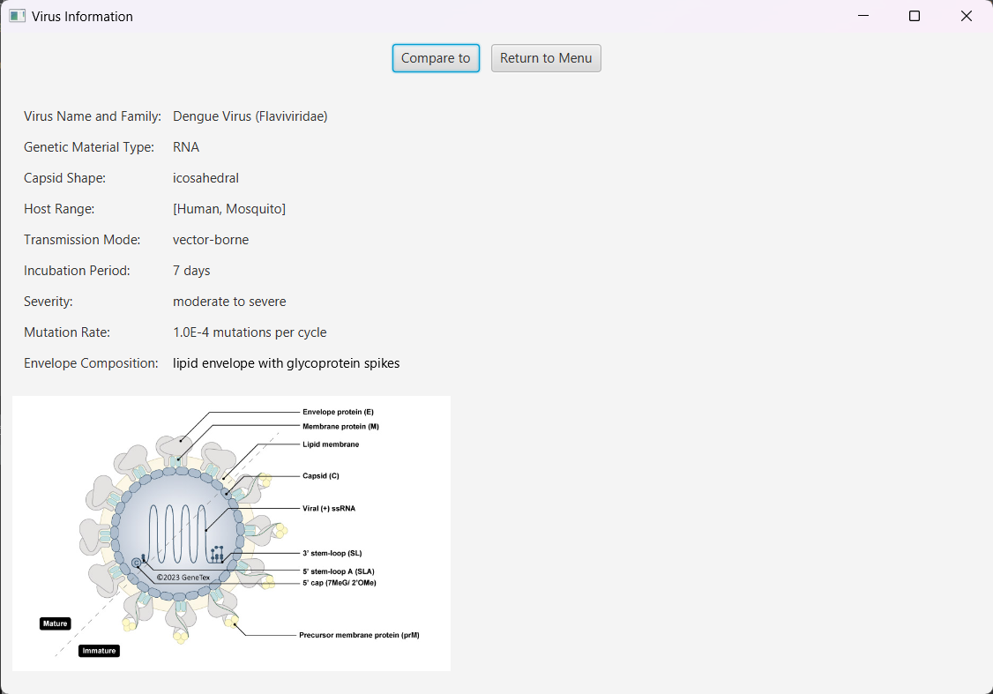
Graphic results
Virus information

Slide 26
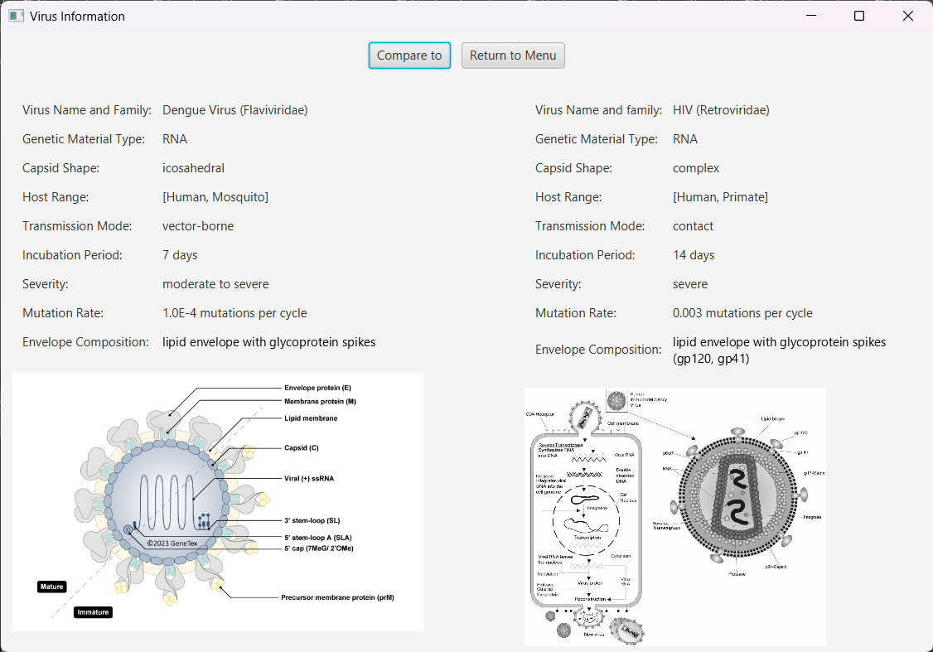
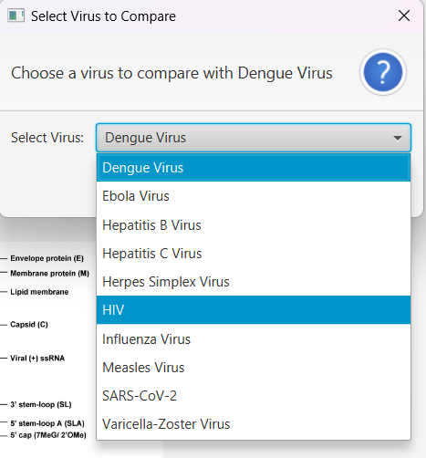
Graphic results
Virus information
We can also compare one virus to the others

Slide 27
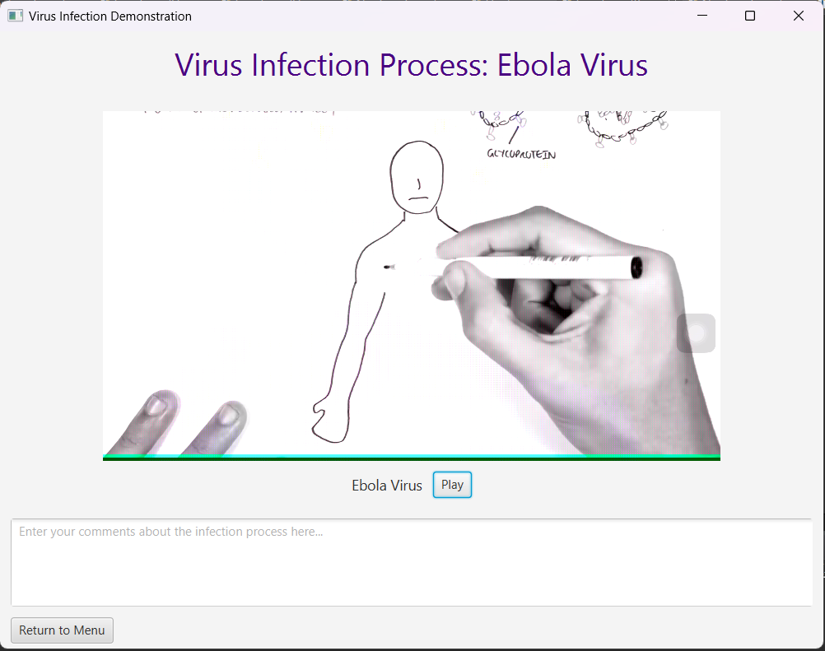
Graphic results
Virus video (demonstration)

Slide 28
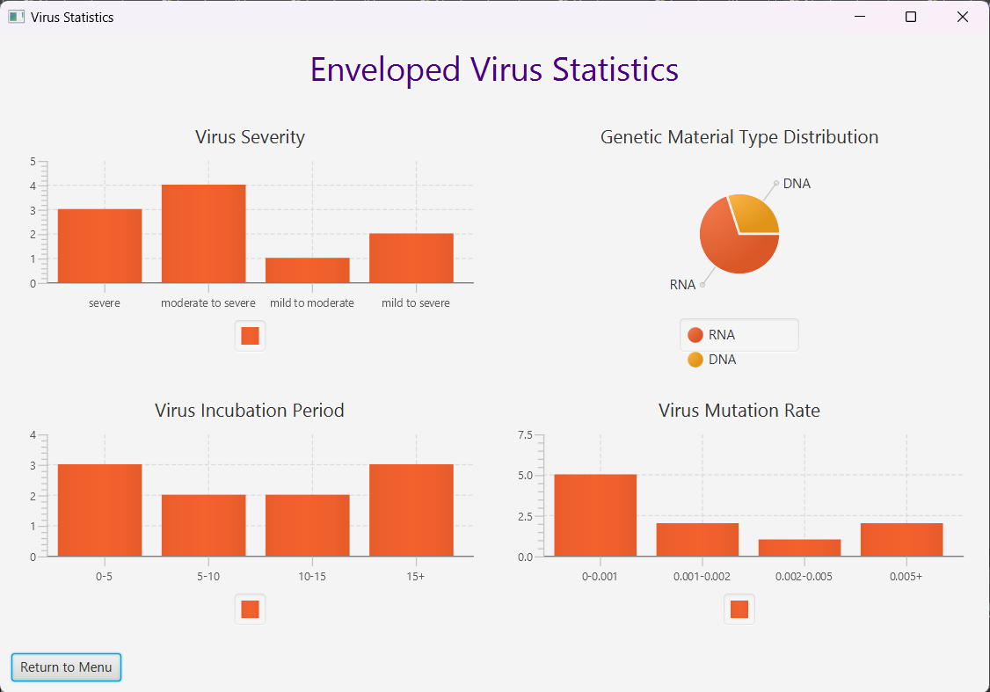
Graphic results
Virus statistics

Slide 29
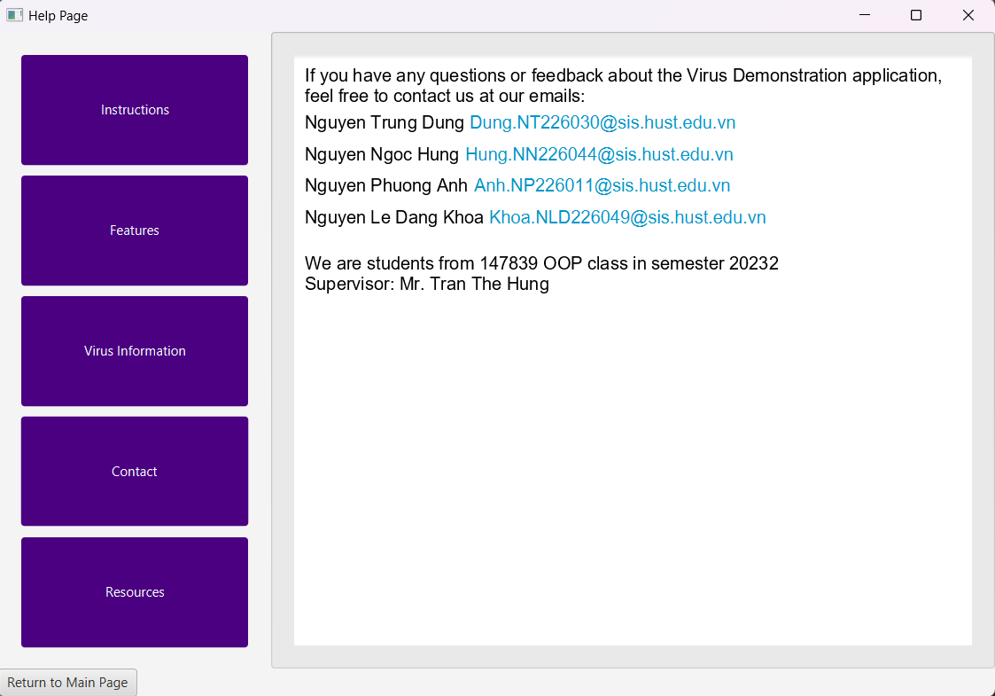
Graphic results
Help page

Slide 30
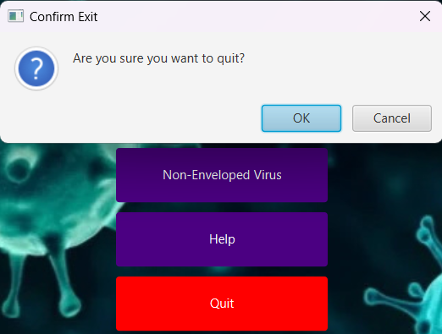
Graphic results
Return and Quit

Slide 31



Slide 32
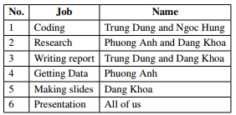
Duty Rolster

Slide 33
Thank you

